Slide 1
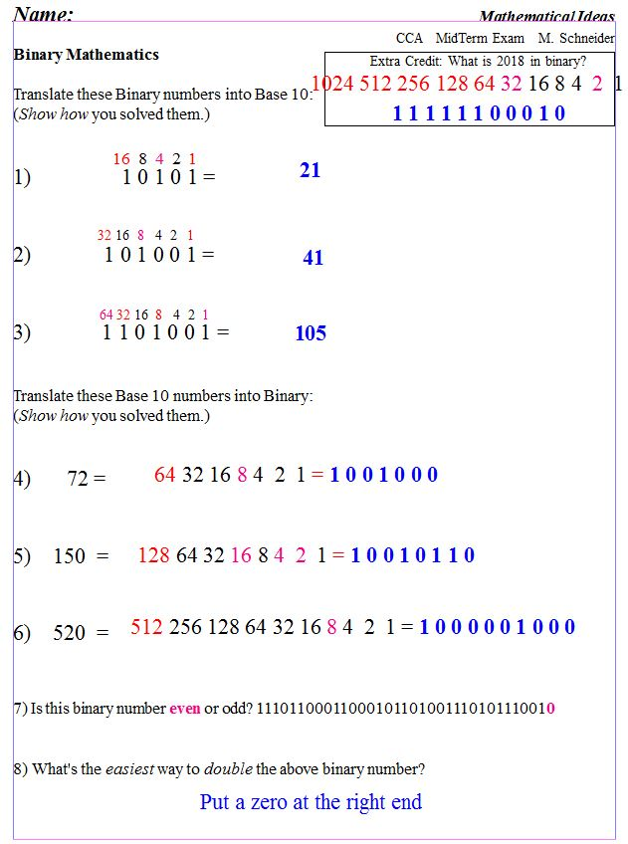
Michael S. Schneider
www.constructingtheuniverse.com
-2
+3
4 points each
-2
4 points each
1 point each

Slide 2
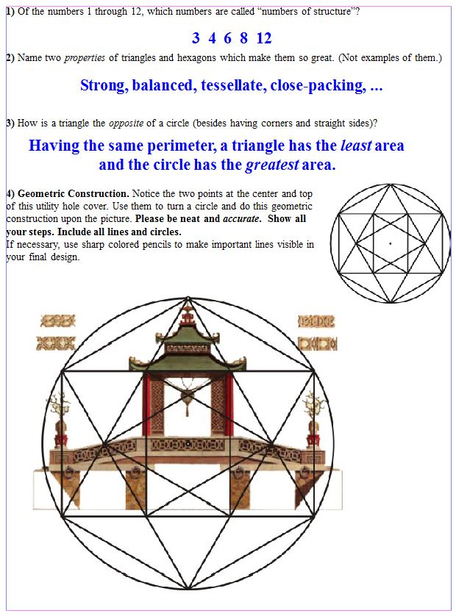
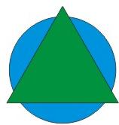
5
2
3
12

Slide 3
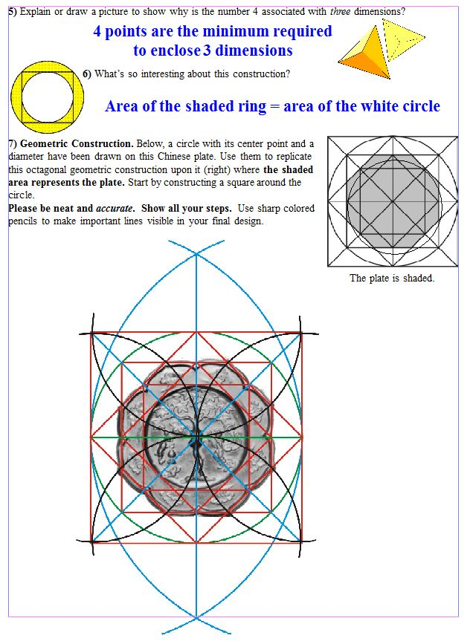
3
3
12
5 for Almond
4 for Petals
3 for Lines
& accuracy

Slide 4
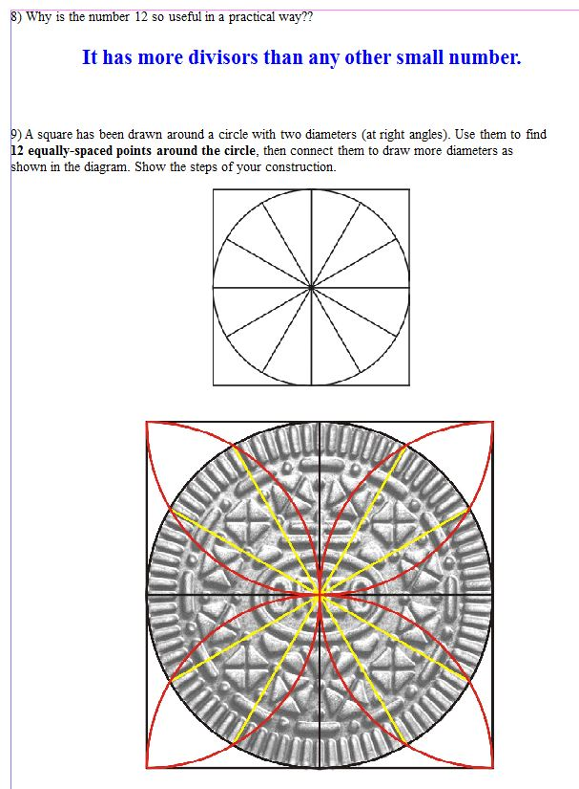
3
and so there are more ways to divide a dozen into parts.
Creates structurally strong shapes.
10

Slide 5
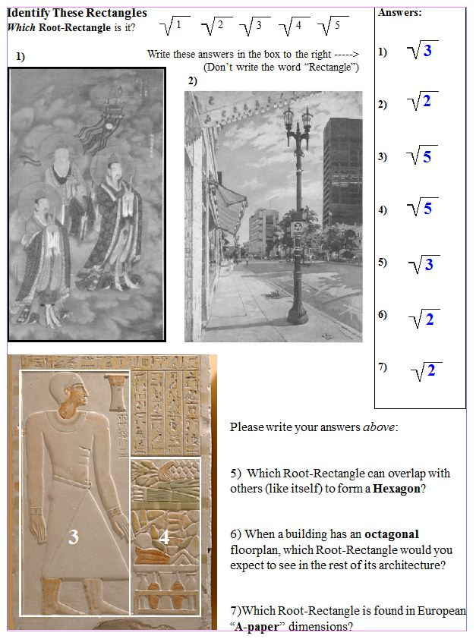
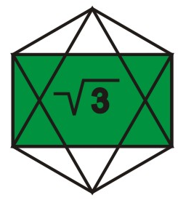
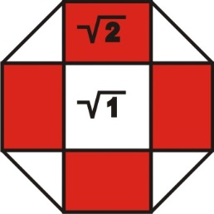
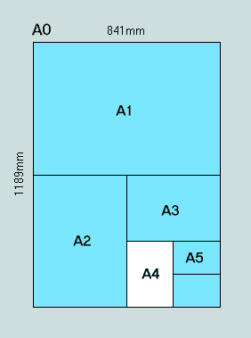
3 points each

